Slide 1
PRESENTATION ON CHAT APPLICATION
AND WEBSITE

Slide 2
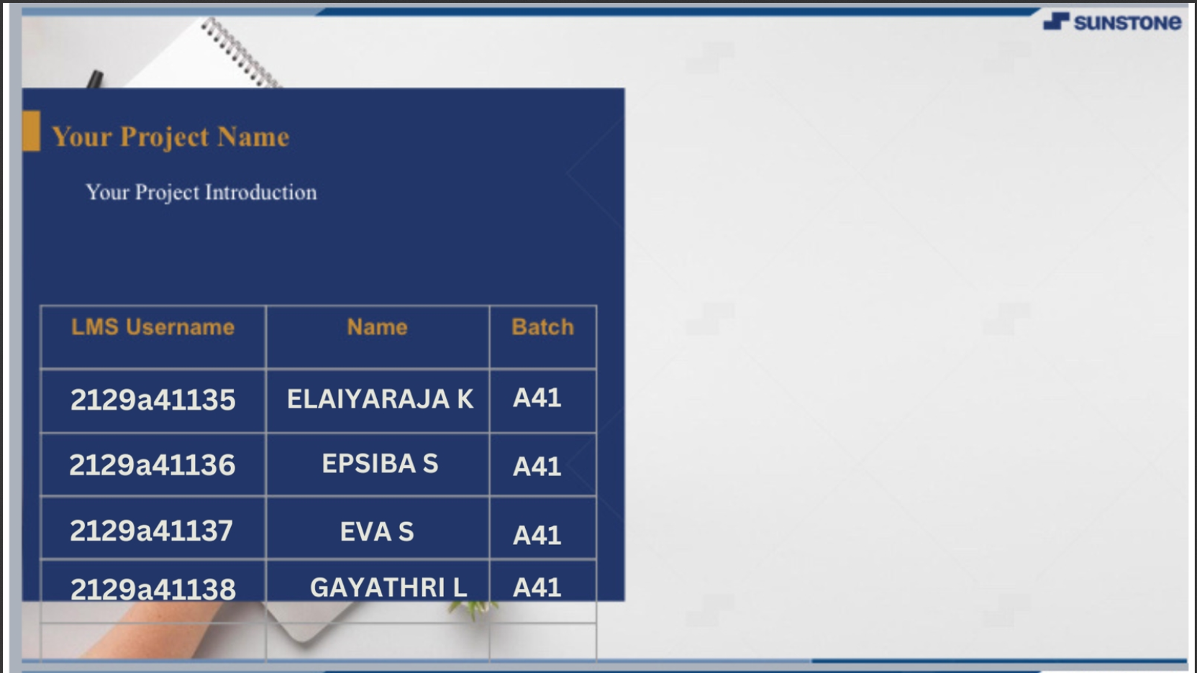

Slide 3

INTRODUCTION
Our Project is an example of chat application which is based on public chatting
Its is made up of two applications
Server application which runs on any PC on network Client application which runs on user’s PC
To start chatting should get connected to server

Slide 4
MODULES
SERVER MODULE
A server is a specially equipped computer connected to Internet that allow user with clients chat to converse with one another typing message in real time
CLIENT MODULE
A client is a software problem that allows user to connect to chat server and communicate with other user via in the chat
room

Slide 5

HARDWARE SPECIFICATIONS
RAM- 2GB HARD DISK-5GB
PROCESSOR -INTEL PENTIUM 4
KEYBORAD-104KEYS

Slide 6

SOFTWARE REQUIREMENTS
JKD 1.8 _20
JRE 8
WINDOWS 7 ORACLE 10g NETBEANS 7.4
5
7

Slide 7



GO
FRONT LINE
4 CHAT
JAVA HTML
Name
Gender
Male
Female
Email ID

Slide 8





BACK END
ORACAL 10g Express Edition
Datebase

Slide 9



DFD
RECEIVER
SENDER
APPLICATION
0- Level DFD

Slide 10



DFD
CHAT APPLICATION
DATABASE
MEMBERS
HOME
ACCOUNTS
SIGN IN
PROFILE
CONTACTS
1-level of DFD

Slide 11


USE CASE DIAGRAM
SHOW ALL
LOGIN
SHOW AVAILABLE
CHANGE PRESENCE
MEMBERS LIST
CHAT HISTORY
USER
CHAT BOX
FILE TRANSFER

Slide 12



CHAT APPLICATION
Chat server aggregate messages from all user and send to all clients
Chat client send user messages to server
Other user clients display aggregated messages from chat server

Slide 13





GO
SCREEN SHOT
4 CHAT
Here user enter the IP address of server
ENTRE IP ADRESS…

Slide 14


LOGIN PAGE
GO
User ID :
4 CHAT
Entre the valid user ID and password then click on submit button
If user is not registered then click on create a new account
Password :
If you forgot your password then click on forgot password button
Forgot Password?
Create an account

Slide 15
SIGNUP PAGE
GO
Name : Gender: User ID: Email: Password:
4 CHAT
Here user entre all the details according to registeration page
Male
Female
user must entre the valid email ID

Slide 16


EMAIL OPTION
To:
|
Subject: Message:
Here user can also send email to one another

Slide 17
CONCLUSION AND SCOPE
There is always a room for improvements in any software package, however good and efficient it may be done. But the most important thing should be flexible to accept further modification Right now we are just dealing with text communication. In future this software may be extended
to include features such as:
File transfer: this will enable the user to send files of different formats to
others via the chat application.
Voice chat: this will enhance the application to a higher level where communication will be possible via voice calling as in telephone.

Slide 18
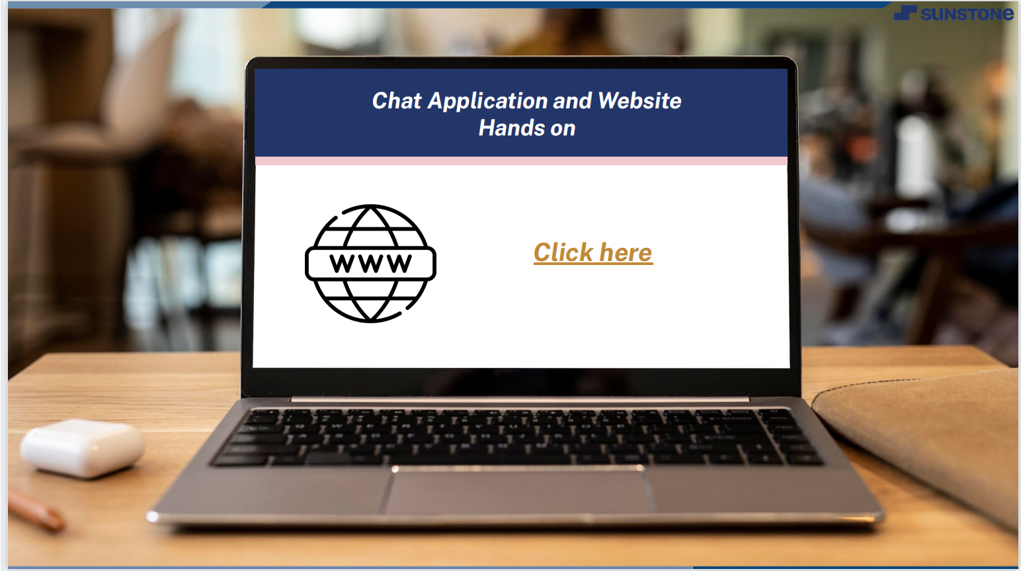

Slide 19



